Slide 1

Battle of the century: Apple vs. Google
Samuel Clémot-Dupont

Slide 2
Which to chose?
Constant debate between Apple and Google play (Android).
Apps available between the two platforms may be a deciding factor (totally speculative (not checked to see if the data supports this)).
For the undecided user, an analysis of the average app review score between the two platforms may be helpful.

Slide 3
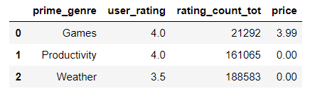
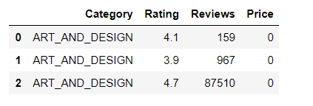
Needed Relevant Information
Apple
Google
Data sourced from Kaggle.
Sub setting the data to Category, rating, price and total reviews are pertinent for further analysis.

Slide 4
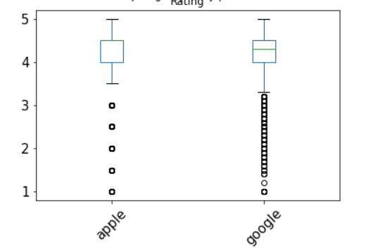
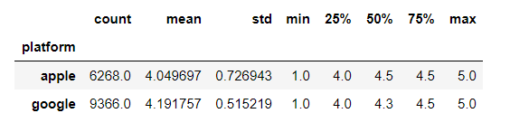
Data Cleaning and Transformation to show respective rating average
Using Jupyter-Notebook, early assessment of the mean ratings indicate some significant difference between the two (0.142) or roughly a 4% increase from Apple.

Slide 5
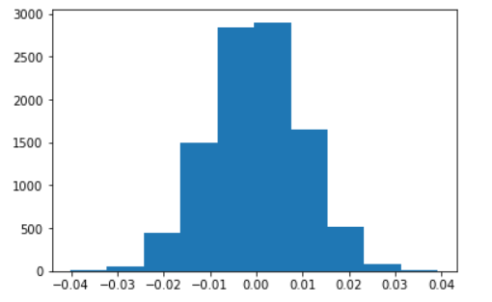
Non-parametric resampling of the data
Resampling of 10000 data points and comparing the platforms mean with each other generally showcase a lesser important difference between the two compared to the 0.142 difference.

Slide 6
Which is better?
Based on the permutation test, it would indicate that googles mean app rating is significantly higher than apples by approximately 4%.
This could suggest that on average google apps may be of better quality
Should this difference be a contributing factor for undecided user remains at the users discretion.

